Slide 1
Osteoarthritis a complex disease with high social economic burden

Slide 2
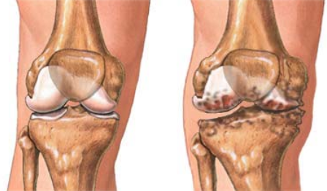
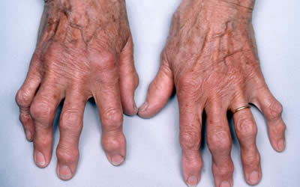
Osteoarthritis (OA)
Degenerative joint disease
Prevalent
No effective treatment
Major cause of disability among elderly affecting mobility and hampering daily life activities

Slide 3
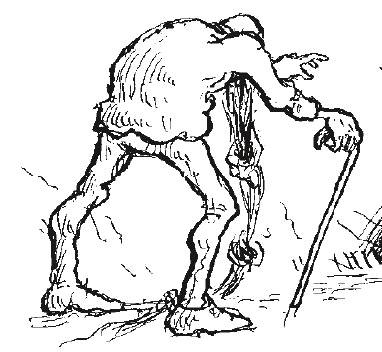
Impediments OA disease management
Complex heterogeneous disease
Little insight in disease etiology
Difficult diagnosis
Severe backlog in development of effective disease modifying OA therapies
Notes:
De kritieke problemen in de management van artrose is het gebrek aan inzicht in de diversiteit van het ziekteproces en de moeilijke diagnose.
Klinische studies includeren een heterogene populatie van artrose patienten. Mismatch tussen behandeling en behoefte patient. Effectiviteit van klinische studies laag. Ik ben er van overtuigd dat de reden waarom effectieve therapie voor artrose ver is achter gebleven bij de enorme behoefte aan een werkend medicijn.

Slide 4
Which step in the Freedman et al strategy?
1. Which type of study is powerful in identifying underlying disease mechanisms?

Slide 5
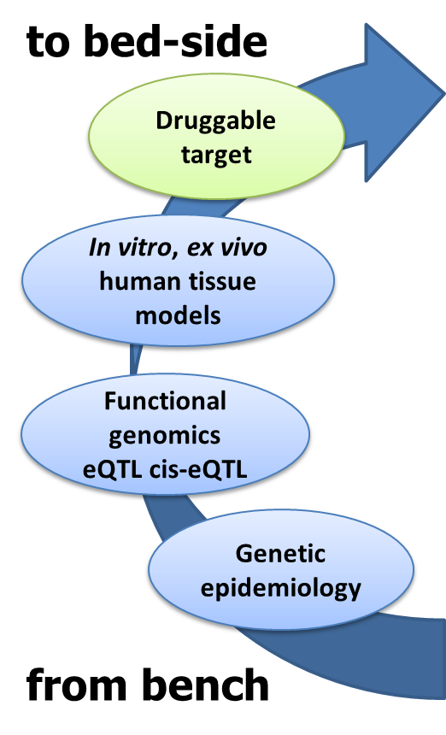

Overview
Novel underlying disease pathways
Novel druggable targets
Notes:
The OA research line at the department of Molecular Epidemiology consists of 2 integrated pilars. One starting from bench to bed side where bottom up approaches via genetic epidemiology and functional genomics novel druggable targets are being recognized and, on the other hand, where we via studies of molecular profiles in cartilage and bone we try to get a more fundamental understanding of the pathophysiology particularly of diverse OA subtypes and development of tools/biomarkers to stratifiy patients according to there disease process.

Slide 6
Heritability and the genetic study design

Slide 7
Balance between heritability and environment
complex genetic
100% environment
100 % genetic
Determines genetic study design

Slide 8
Osteoarthritis - Heritability

Slide 9
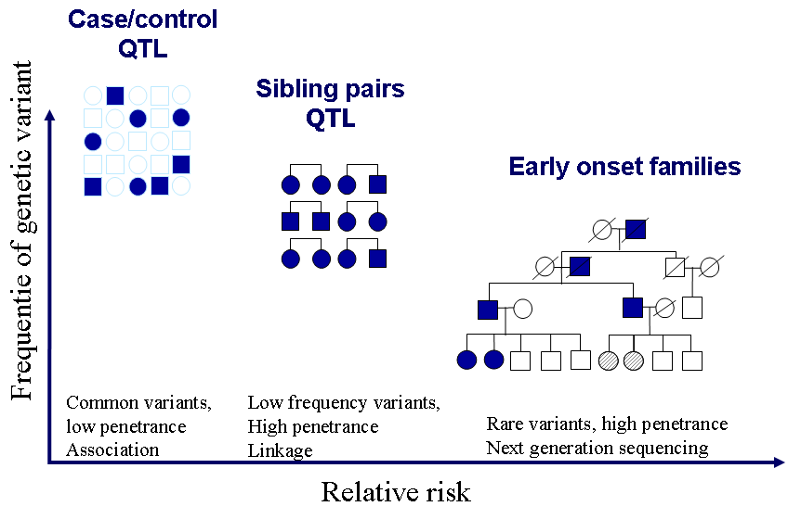
Study design depends on inheritance pattern

Slide 10
Association analyses case/controls
Cases and controls
Complex phenotype (common)
Model free
Sharing of alles between cases versus controls
Use SNPs close together
Finding association is about finding genes / pathways changing your risk to develop disease

Slide 11
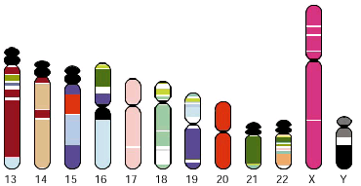
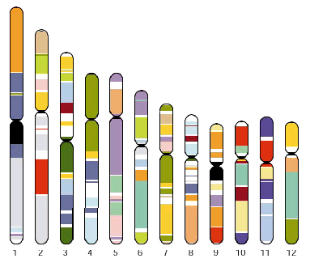
Possible genetic approaches
b
Candidate genes
Genome wide scan
Hypothesis driven - Educated guess
Discovery driven -Acknowledged lack of knowledge

Slide 12
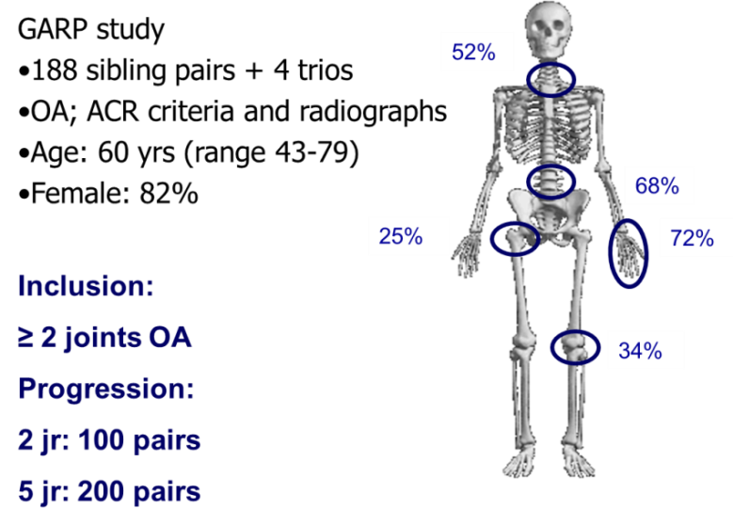
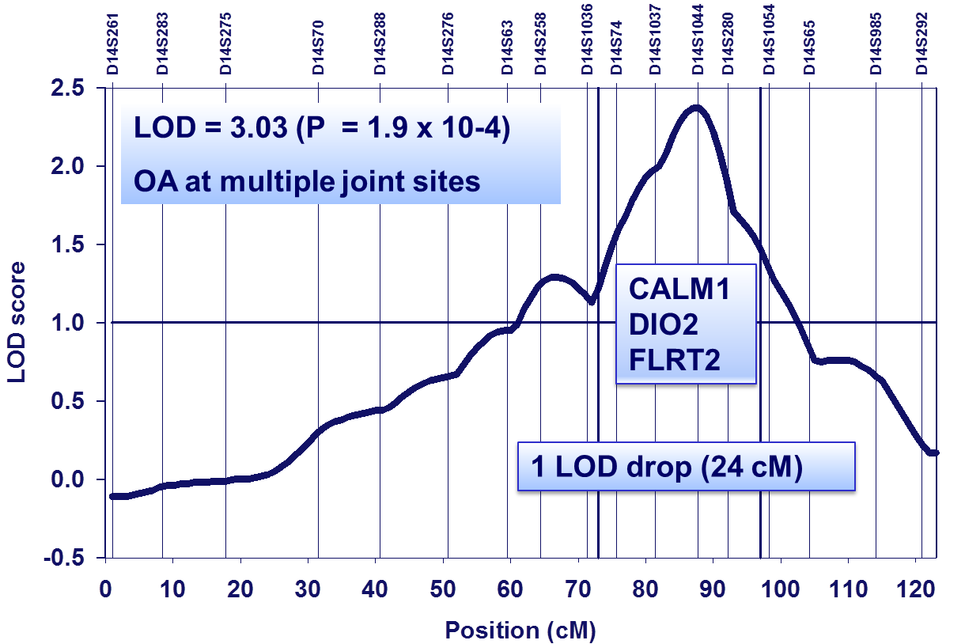
Identification of DIO2 as OA susceptibility locus The GARP study
2008
Initial study to indicate thyroid signaling conferring risk to osteoarthritis
Meulenbelt et al. 2008 Hum Mol Genet 17: 1867-75

Slide 13
How to delineate the risk locus?

Slide 14
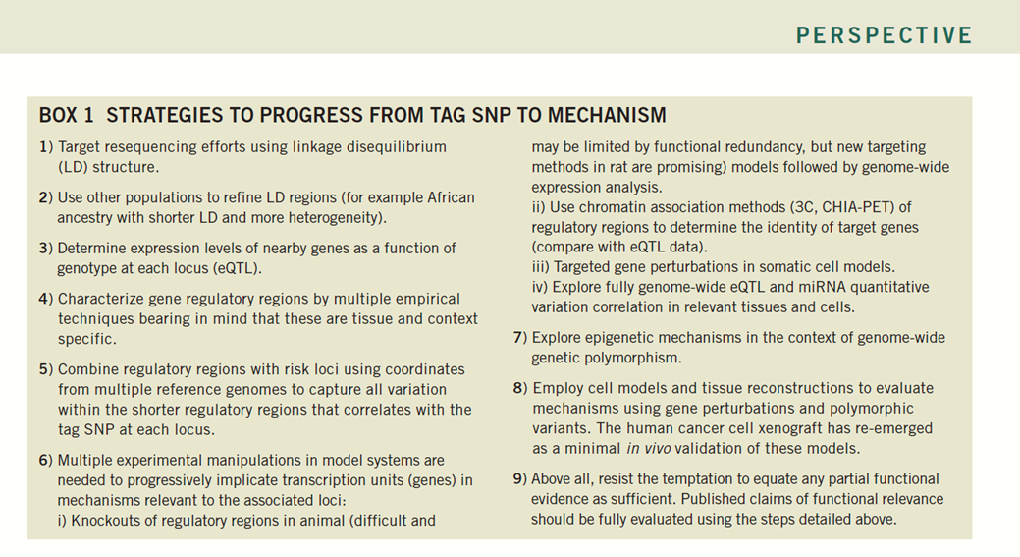
Which step in the Freedman et al strategy?
1. Using linkage disequilibrium (LD structure) to find candidate gene

Slide 15
DIO2, OA susceptibility gene The Garp study, combined linkage association
Gene | SNP reference | allele | alias | MAF | P-value
DIO2 | rs12885300 | C>T | ORFaGly3Asp | 0.36 | 0.04
 | rs2267872 | G>A |  | 0.09 | 0.30
 | rs225011 | T>C |  | 0.43 | 0.14
 | rs225014 | T>C | Thr92Ala | 0.36 | 0.006
 | rs10136454 | C>T |  | 0.02 | 0.60
Meulenbelt et al. 2008 Hum Mol Genet 17: 1867-75

Slide 16
Are we convinced of this locus being a strong risk gene?

Slide 17
Which step in the Freedman et al strategy?
Used other populations to refine LD regions / association to pinpoint a strong OA risk candidate gene

Slide 18
Initial replication, OA susceptibility gene DIO2 haplotype rs12885300-rs225014 C-c
Female cases severe hip OA
Gene | OR Recessive model | P of OR | P value heterogeneity test
All* | 1.8 (1.4-2.3) | 2x10⁻⁵ | 0.6
UK (Oxford) | 2.1 (1.4-3.2) | 0.001
NL (R’dam) | 1.9 (1.0-3.5) | 0.040
Japan (Riken) | 1.5 (1.0-2.3) | 0.047
*Random effect meta-analyses
Meulenbelt et al. 2008 Hum Mol Genet, 17:1867-75.

Slide 19
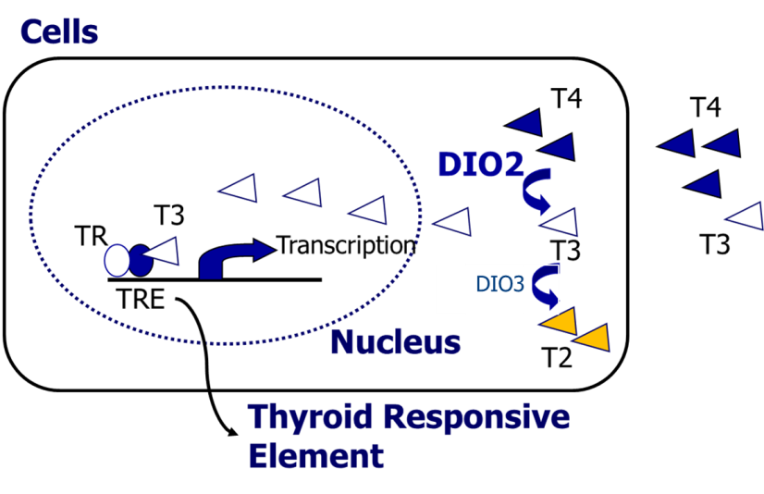
Identification of DIO2 as OA susceptibility locus The GARP study
Initial study to indicate thyroid signaling conferring risk to osteoarthritis
Meulenbelt et al. 2008 Hum Mol Genet 17: 1867-75

Slide 20
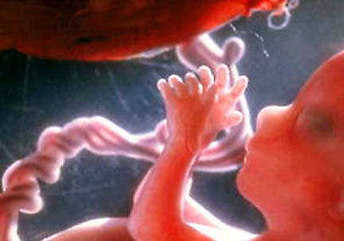
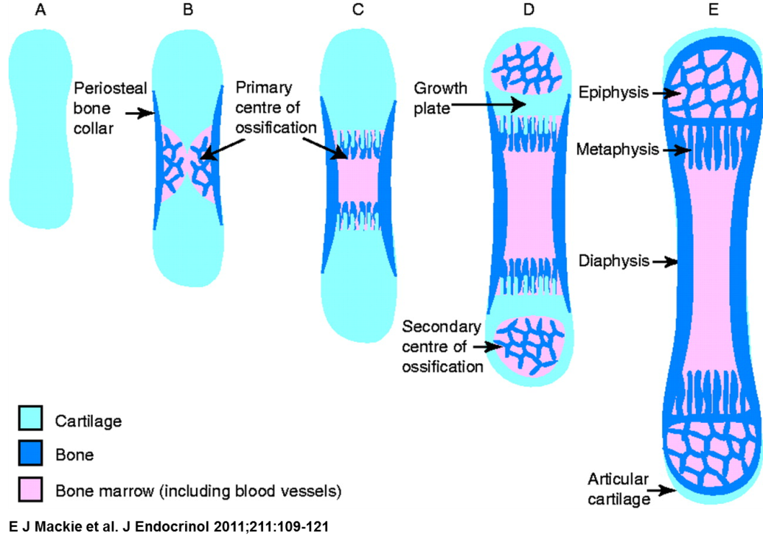
Growth plate; elongation of long bones via endochondral ossification
Stem cells
Growth plate chondrocytes
Proliferation
Hypertrophic Mineralization
Bone
T4
DIO2
T3
Active intracellular thyroid (T3) triggers terminal maturation of growth plate chondrocytes to allow transition to bone
Wang et al. 2007 J bone and Min Res. 22; 1988-95
Notes:
In the growth plate, elongation of long bones is assured via the developmental process of endochondral ossification. In this process intracellular T3 signals the terminal maturation of growth plate chondrocytes characterized by cartilage mineralization and breakdown to allow the transition to bone.

Slide 21
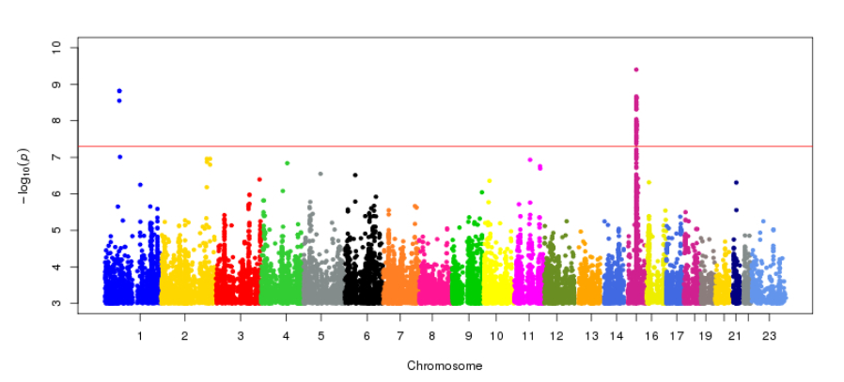
Additional OA genes in thyroid pathway
Large scale genome wide meta analyses of osteoarthritis; ALDH1A2, NCOA3
Styrkarsdottir et al. 2014 Nat Genet 46: 498-502
Evangelou et al. 2014 Ann Rheum Dis 73:2130-6
Notes:
More recently, however, large genome wide meta analyses of osteoarthritis have provided compelling genome wide significant genes additionally involved in orchestrating intracellular thyroid signalling. Indicating that intracellular thyroid signaling may be a common underlying OA pathway.

Slide 22
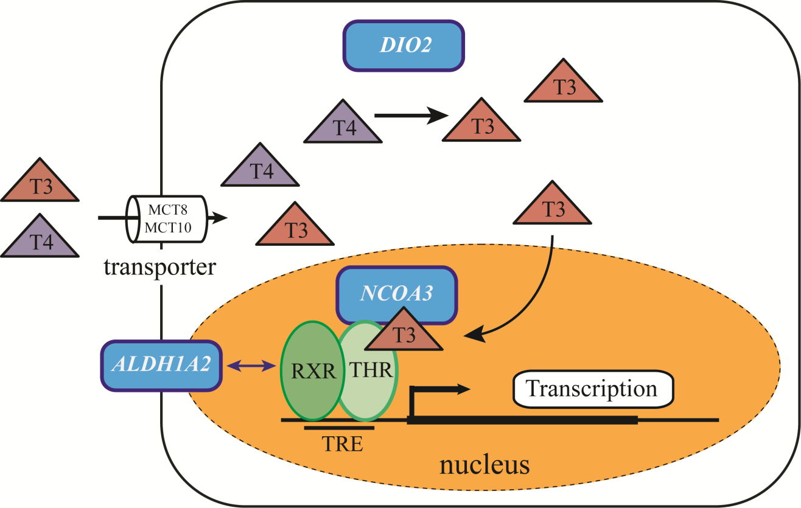
Intracellular levels of active thyroid
DIO3
Intracellular thyroid signaling may be a common underlying osteoarthritis pathway
Notes:
Together these genes orchestrate the availability of intracellular levels of active thyroid hormone in specific tissues such as the growth plate.

Slide 23
Formulate hypothesis

Slide 24
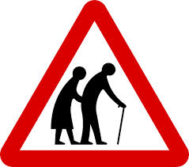
Developmental process of endochondral ossification Late cause of a late life disease?
Notes:
So it appeared that the cartilage of DIO2 risk allele carriers itself was more prone to OA development

Slide 25

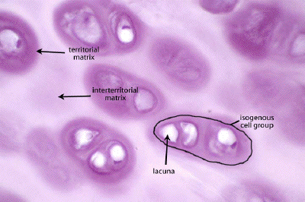
Articular chondrocytes
Highly specialized, post-mitotic cell
Maturational arrested
Require phenotypic plasticity and shift between active metabolic and maturational arrested states to respond to environmental challenges.
Healthy articular cartilage
Notes:
In this respect it should be noted that articular chondrocytes escaped this maturational process to populate as single cell the articular cartilage. Where this highly specialized cell does not proliferate and remains in a maturational arrested state throughout life. , active silencing of endochondral ossification signaling

Slide 26
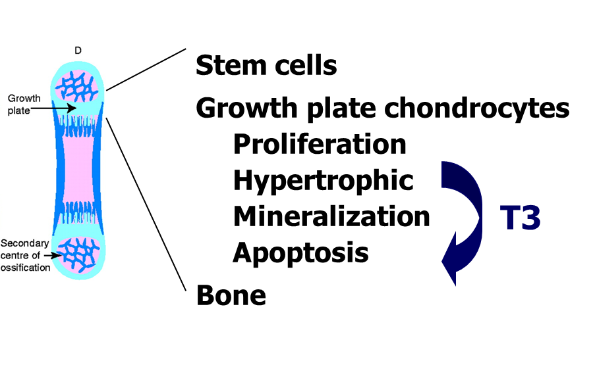
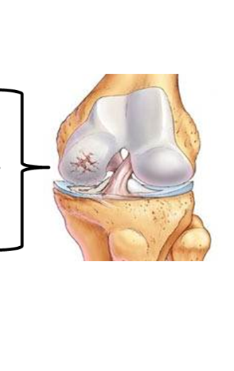
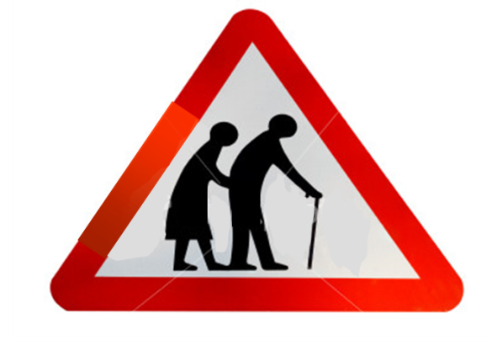
Endochondral ossification and Osteoarthritis Late life effect of DIO2
Late life
disruption of epigenetic silencing of thyroid signaling in articular cartilage
Loosening of maturational arrested state
Debilitating cartilage signaling
Osteoarthritis susceptibility
Notes:
If we think about possible late life effects of thyroid signalling similarities between growthplate chondrocytes and osteoarthritic chondrocytes are studied.

Slide 27
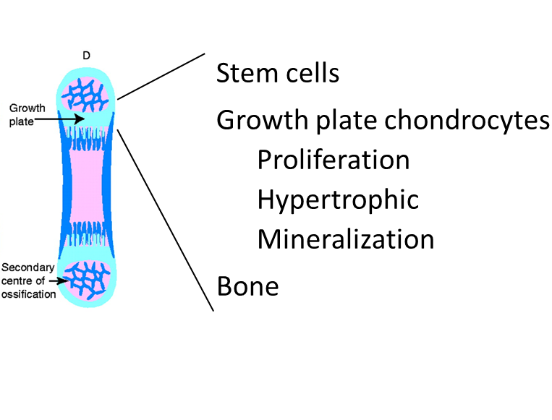
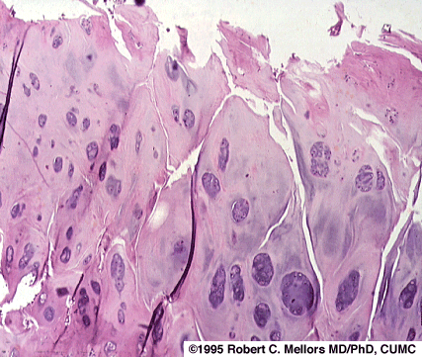
Chondrocytes in OA pathophysiology
Loss of maturational arrested state and recuperation of growth plate morphology
Proliferation, while degrading and calcifying the articular cartilage matrix.
OA affected articular cartilage
OA phenotype in articular cartilage; developmental process of endochondral ossification
Notes:
Do we have any reason to believe that these processes occur in OA

Slide 28
The recuperation of thyroid signaling in osteoarthritic cartilage?
But to do functional studies disease tissue and in vitro cell models are necessary

Slide 29
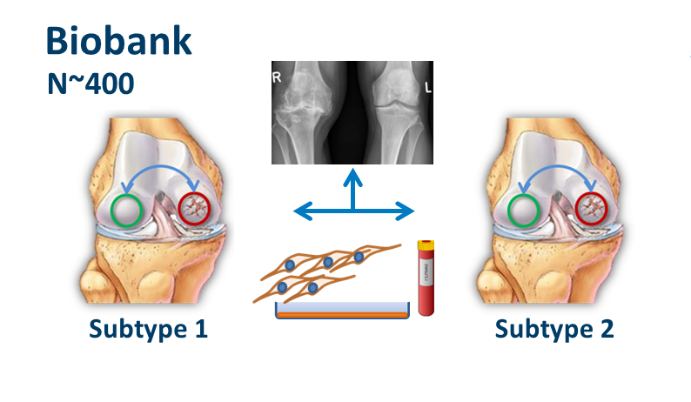
Research Articular osteoArthrits Cartilage
RAAK study (collaboration with Orthopaedics, RGHH Nelissen)
Collection of joint tissues of OA patients: preserved and lesioned cartilage, DNA, RNA, blood and cells (MSCs and primary chondrocytes).

Slide 30
Functional characterization of the DIO2 risk locus

Slide 31
What would be your primary questions?
Gene:
Expression gene/protein is disease relevant tissue
Is the gene responsive to disease process

Slide 32
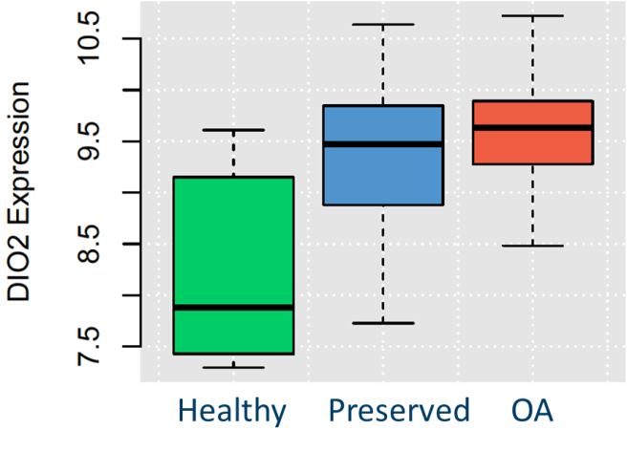
DIO2 expression in articular cartilage
DIO2 mRNA expression high in OA cartilage compared to healthy
Ijiri et al. 2010
2010
Notes:
DIO2 as OA susceptibility gene in genome wide linkage
AI observed marked by rs225014
Upregulation of DIO2 protein in OA affected chondrocytes (brown spots)
Whereas others have shown that locally induced DIO2 expression leads to OA in rats

Slide 33
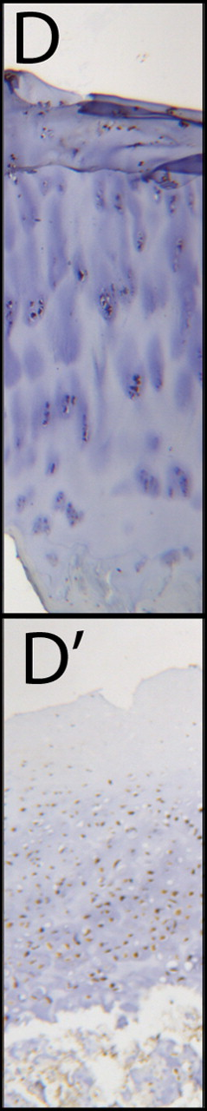
DIO2 protein expression in articular cartilage
DIO2 mRNA expression high in OA cartilage compared to healthy
Ijiri et al. 2010
2010
DIO2 protein expression up regulated in OA affected cartilage
Bos et al. 2012
2012
Notes:
DIO2 as OA susceptibility gene in genome wide linkage
AI observed marked by rs225014
Upregulation of DIO2 protein in OA affected chondrocytes (brown spots)
Whereas others have shown that locally induced DIO2 expression leads to OA in rats

Slide 34
What would be your next question?
Determined expression levels of nearby genes as a function of genotype at each locus (eQTL).
..in disease relevant tissue!

Slide 35
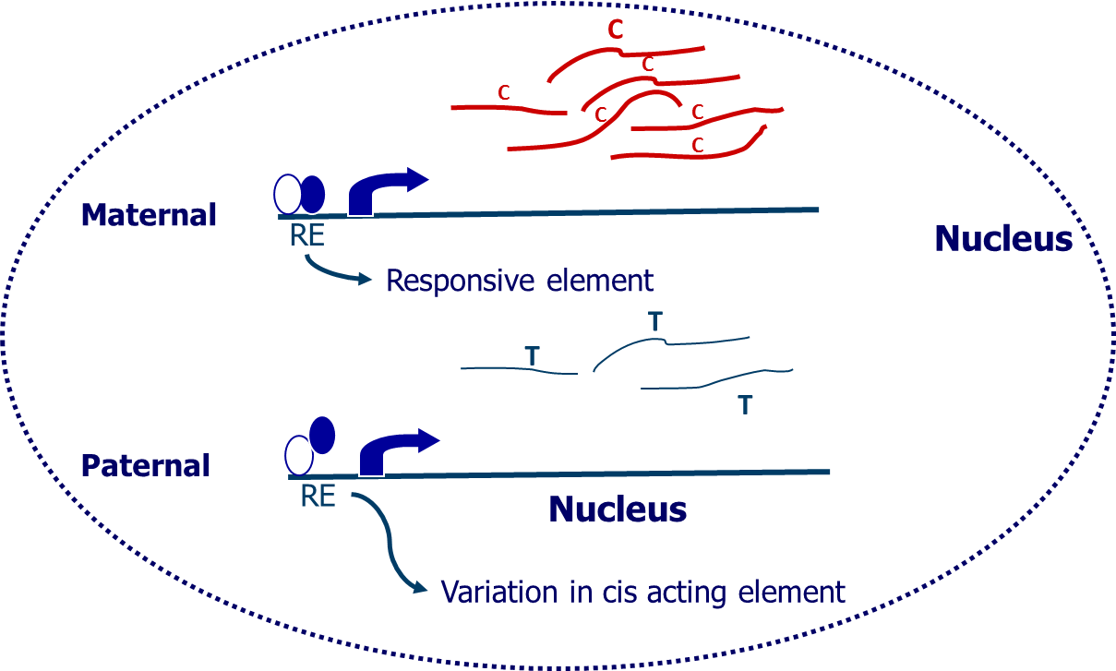
Does the SNP affect expression of positional gene?
Test functional relevance of susceptibility SNPs:
SNPs in regulatory elements
Differences in RNA stability
Epigenetic mechanisms
Tissues
Subtle changes in expression regularly underlie complex diseases.

Slide 36
Differential allelic expression Genetic variation at cis-acting regulator elements
C
C
C
C
C
C
C
Maternal
RE
Nucleus
Responsive element
T
T
T
Paternal
T
RE
Nucleus
Variation in cis acting element
Bos et al. Ann Rheum Dis. 2012
Measurable with coding SNPs

Slide 37
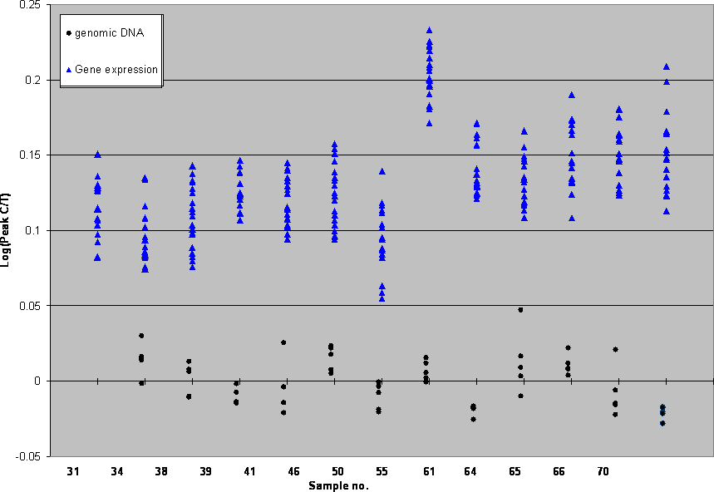
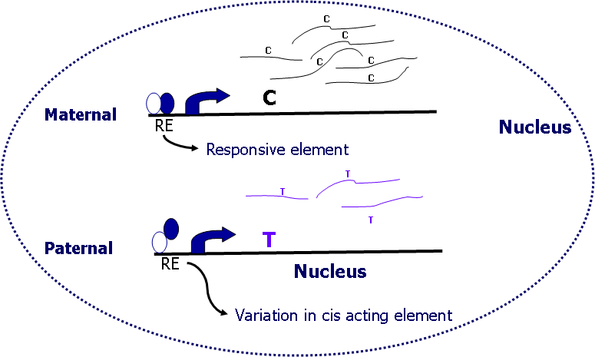
Differential allelic expression DIO2
Significant increased expression of the DIO2 susceptibility allele in OA cartilage

Slide 38
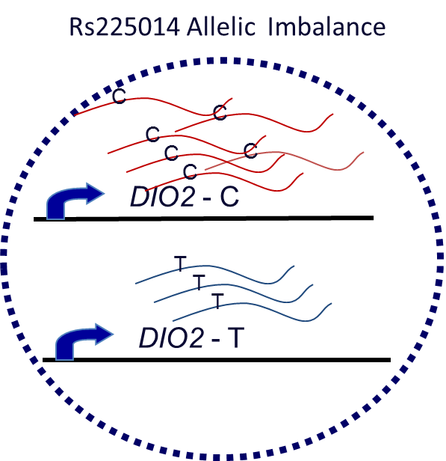
DIO2 in articular cartilage
DIO2 mRNA expression absent in healthy and high in OA cartilage
Ijiri et al. 2010
2010
Allelic imbalance & protein up regulation
Bos et al. 2012
2012
Potential relevance DIO2 in OA pathology
Cis-eQTL function & direction of effect of risk allele

Slide 39
Which next step in the Freedman et al strategy?
Characterized gene regulatory regions by multiple techniques
..in disease relevant tissue!

Slide 40
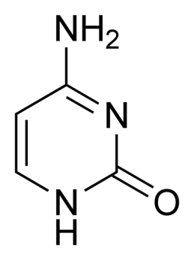
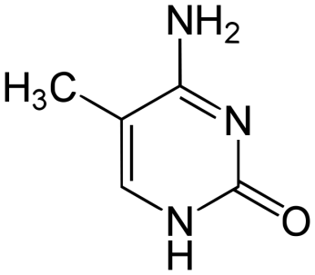
Epigenetics – DNA methylation
Mechanisms to adapt to environmental changes such as mechanical stress, disease and age.
miRNAs
Histon modifications
DNA methylation
…
Mechanisms to adapt to environmental changes such as mechanical stress, disease and age.
miRNAs
Histon modifications
DNA methylation
…
DBP
DBP
DBP
DBP

Slide 41
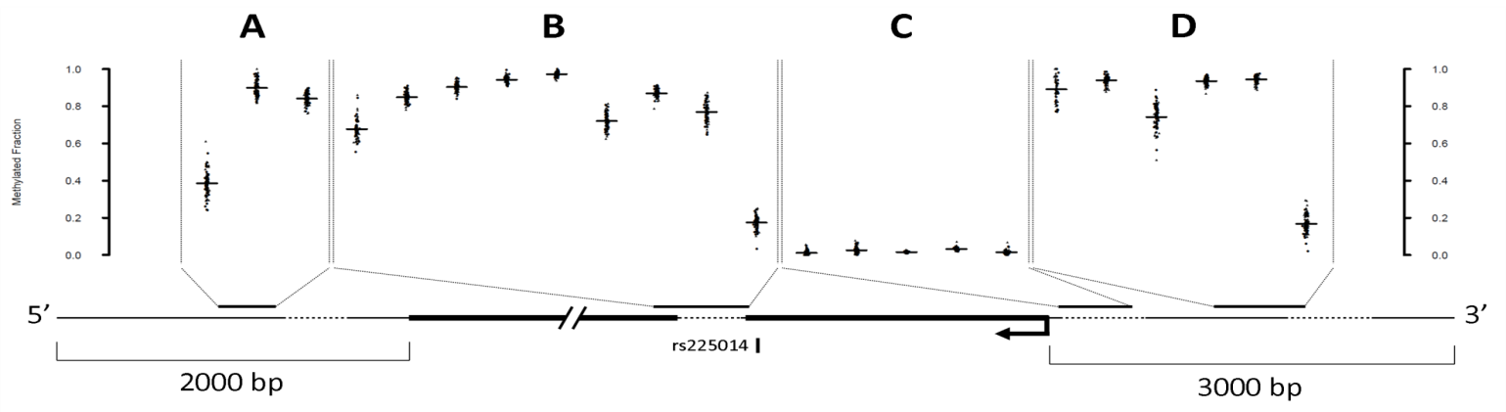
Regulation of DIO2 expression
Gene targeted methylation at CpG sites (Epityper, Sequenom)
N. Bomer, W den Hollander and YFM Ramos et al. ARD 2015

Slide 42
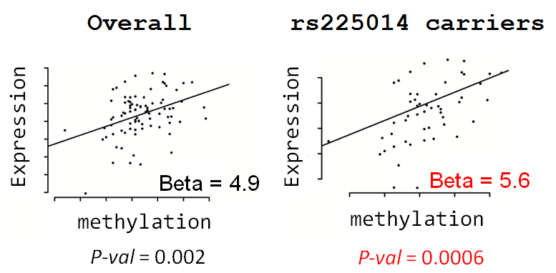
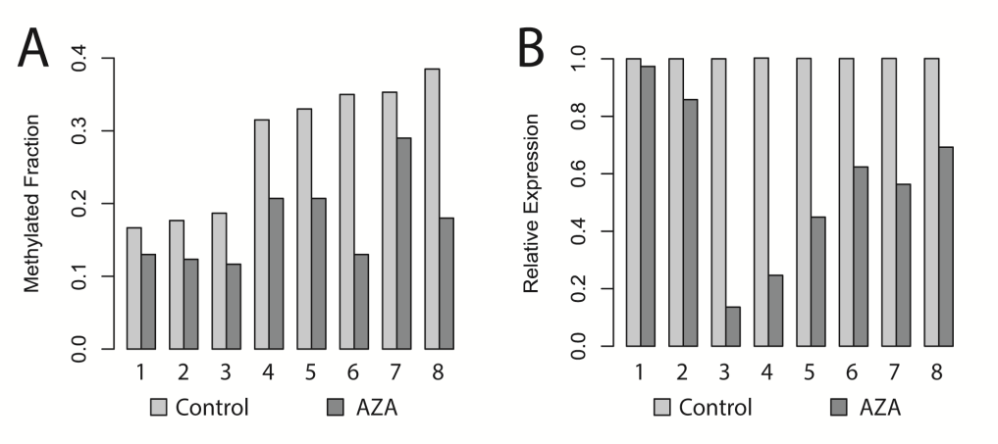
Regulation of DIO2 expression
Gene targeted methylation at CpG sites (Epityper, Sequenom)
DIO2 expression in articular cartilage is modulated by methylation at CpG ~-2000 bp
N. Bomer, W den Hollander and YFM Ramos et al. ARD 2015

Slide 43
Which next step in the Freedman et al strategy?
Characterized gene regulatory regions by multiple techniques
Explore epigenetic mechanisms in the context of genome wide genetic polymorphisms
..in disease relevant tissue!

Slide 44
Does the DIO2 rs255014 modulates the effect?

Slide 45
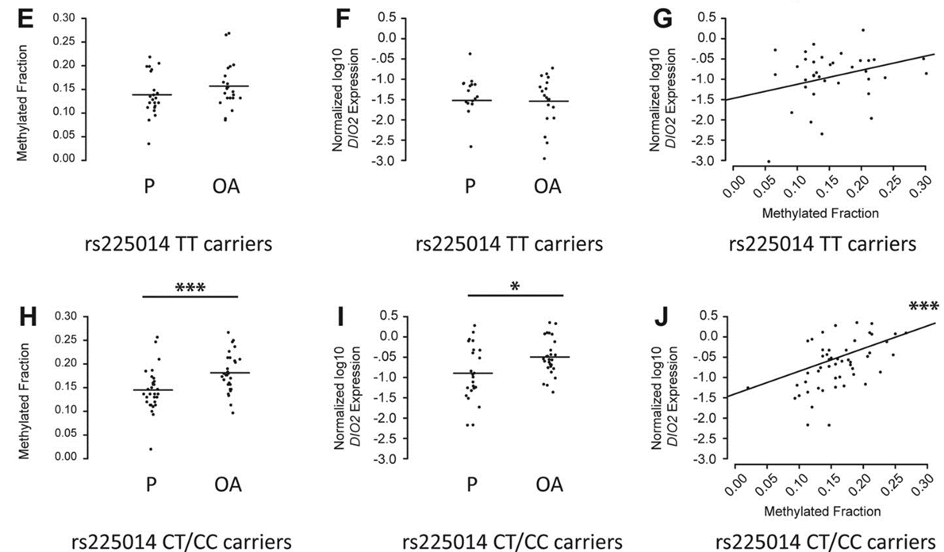
Regulation of DIO2 expression
Gene targeted methylation at CpG sites (Epityper, Sequenom)
DIO2 expression is more sensitive to methylation changes in rs225014 risk allele carriers.
N. Bomer, W den Hollander and YFM Ramos et al. ARD 2015

Slide 46
T
Healthy
Osteoarthritic
DIO2 unmethylated
DIO2 methylated
X
CTCF
C
CTCF

Slide 47
Which step in the Freedman et al strategy?
Employ (in vitro) cell models and tissue reconstructions to evaluate mechanisms using gene perturbations and polymorphic variants.
..in human tissue!

Slide 48
Human 3D in vitro model of cartilage
What is direct effect of DIO2 upregulation?

Slide 49
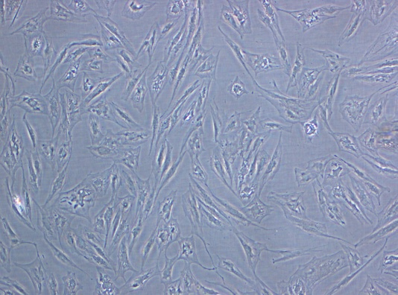
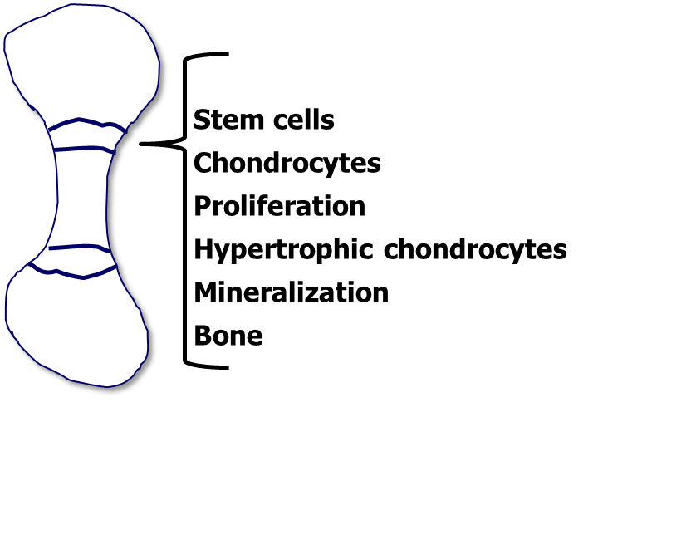
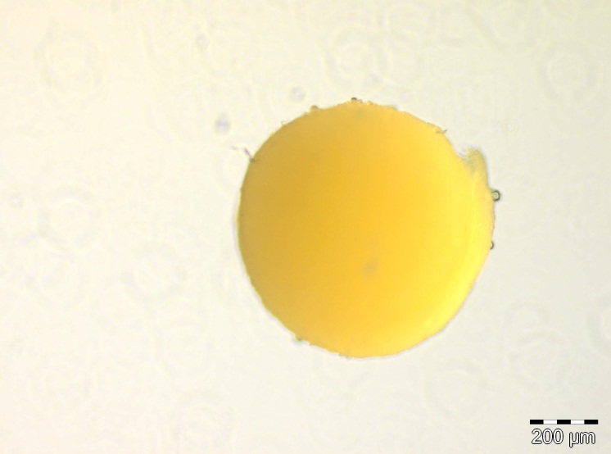
Human in vitro chondrogenesis model
Stemcells, primary chondrocytes
Growing cells (monolayer)
Chondrocyte pellet cartilage formation

Slide 50

In vitro chondrogenesis model
Stemcells, primary chondrocytes
In vitro chondrogenesis model using human bone marrow derived mesenchymal stem cells. Alcian blue staining
What is direct effect of DIO2 upregulation on cartilage integrity?
N. Bomer, W den Hollander and YFM Ramos et al. ARD 2015

Slide 51
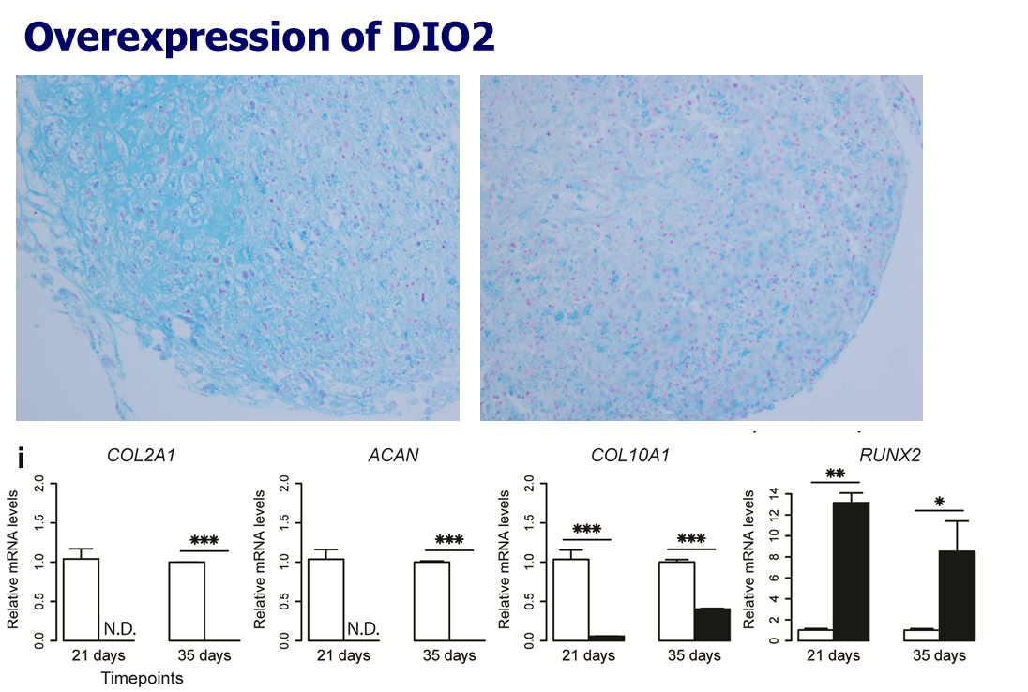
BM-MSC based in vitro chondrogenesis model
eGFP
DIO2
Direct detrimental effect of DIO2 on cartilage matrix deposition
Destruction without early hypertrophy (COLX)
N. Bomer, W den Hollander and YFM Ramos et al. ARD 2015

Slide 52
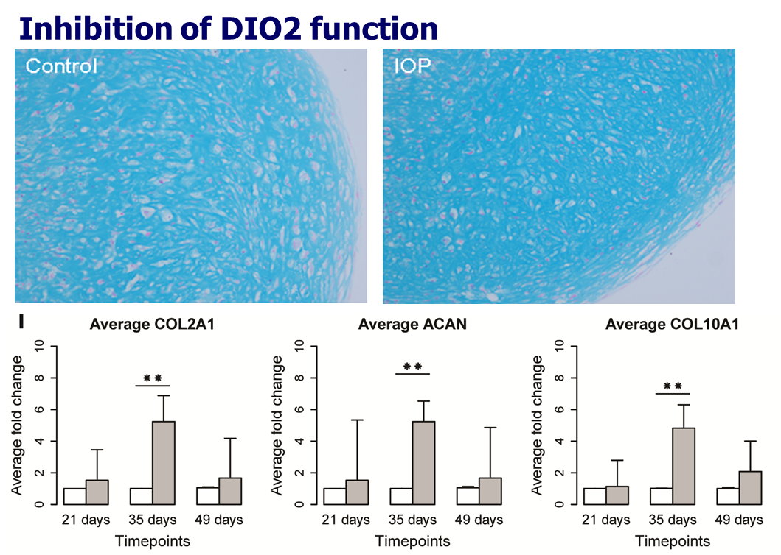
BM-MSC based in vitro chondrogenesis model
IOP = Iopanoic acid, an oral cholecystographic agent, an effective inhibitor of iodothyronine deiodinase and medication for thyrotoxicosis. Tyer et al. Endocr Pract. 2014 20 (10):1084-1092
Beneficial effect of DIO2 on cartilage matrix deposition
Early hypertrophy (COLX), no destruction
N. Bomer, W den Hollander and YFM Ramos et al. ARD 2015

Slide 53
Conclusions human in vitro studies DIO2
Direct detrimental effect of DIO2 on cartilage matrix deposition .
Beneficial effect of DIO2 on cartilage matrix deposition
What about in vivo studies?

Slide 54
Which step in the Freedman et al strategy?
Multiple experimental manipulations in model systems are needed to progressively implicate transcription units (genes) in mechanisms relevant to the associated loci

Slide 55
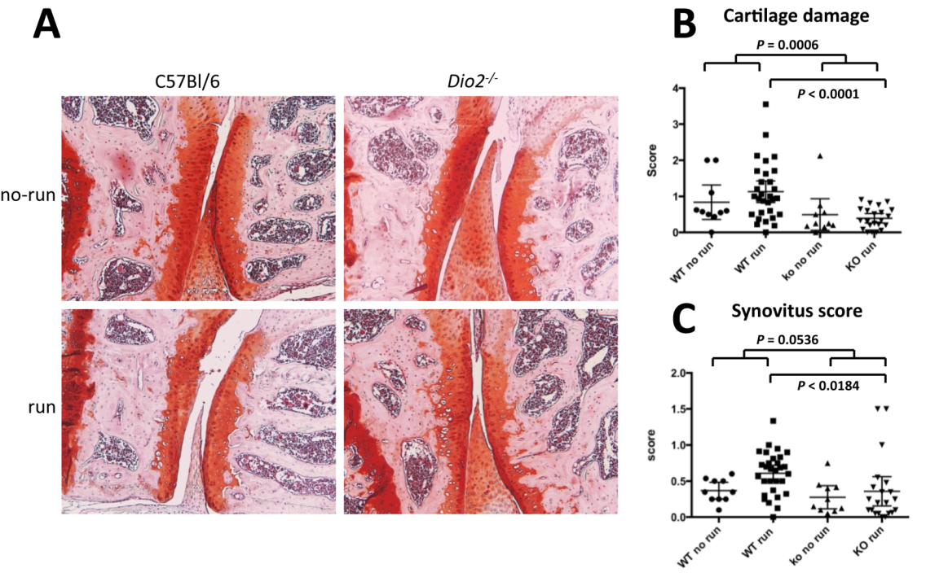
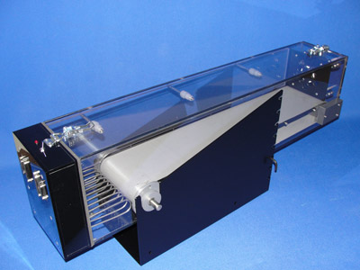
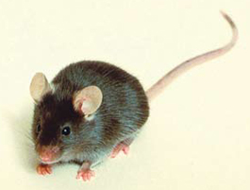


DIO2 Knock-Out model Collaboration KU Leuven, Leuven, Belgium
Design: Running induced mechanical stress
DIO2-KO & Control (C57BL/6 males)
+
For 3 weeks -> 5 days/week -> 60 min/day
(60min at 11m/min, 5 incline)
→
Induce cartilage damage
Dio2-/- mice protected against cartilage damage only upon exercise-induced OA Bomer et al. Ann Rheum Dis. (2015)
2015
Notes:
Next we translated this finding into an animal model, where we used the design of running induced mechanical stress in which mice, Dio2 KO and Control, are exposed to a 3 week forced running regime to induce cartilage damage.
What we found was that DIO2-deficient are protected against cartilage damage in a model of exercise induced OA.

Slide 56
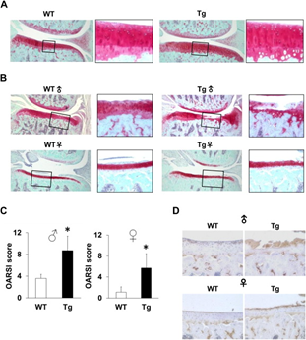
Tissue specific induction DIO2 in rats
Destruction of cartilage only upon applying OA model Nagase et al. Ann Rheum Dis 2013
2013
eGFP
DIO2

Slide 57
Conclusions in vitro animal studies DIO2
Tissue specific upregulation of DIO2 in rat cartilage
Prone to OA after applying OA model
DIO2 knock out mice protected against cartilage damage only upon exercise-induced OA
Notes:
For a number of OA susceptibility genes evidence is reported for disrupted regulation of expression due to altered DNA methylation, or in other words: epigenetic changes may underlie OA susceptibility.
→ To study genome wide DNA methylation we made use of the RAAK study

Slide 58
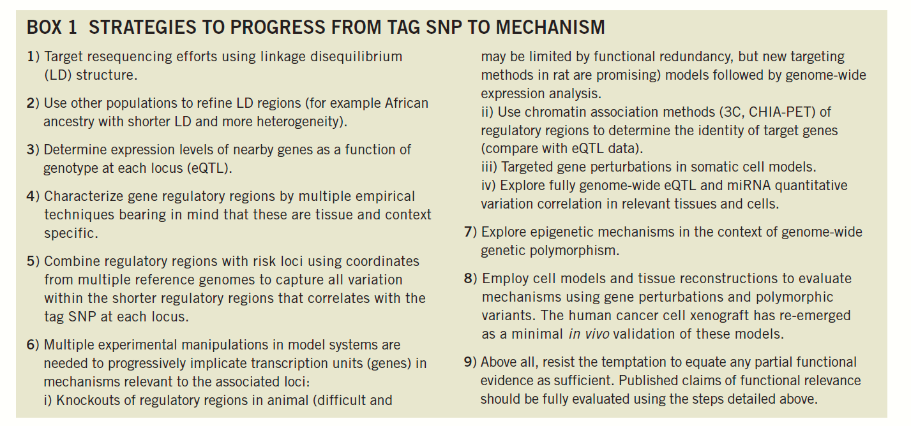

Slide 59

Dutch Arthritis Association Grant
Pharmacological attenuation of thyroid hormone signaling; An evidence-based treatment option for Osteoarthritis

Slide 60

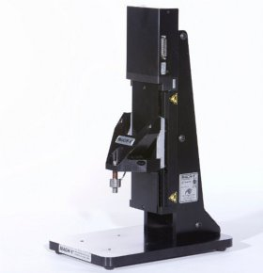

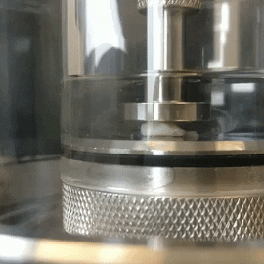
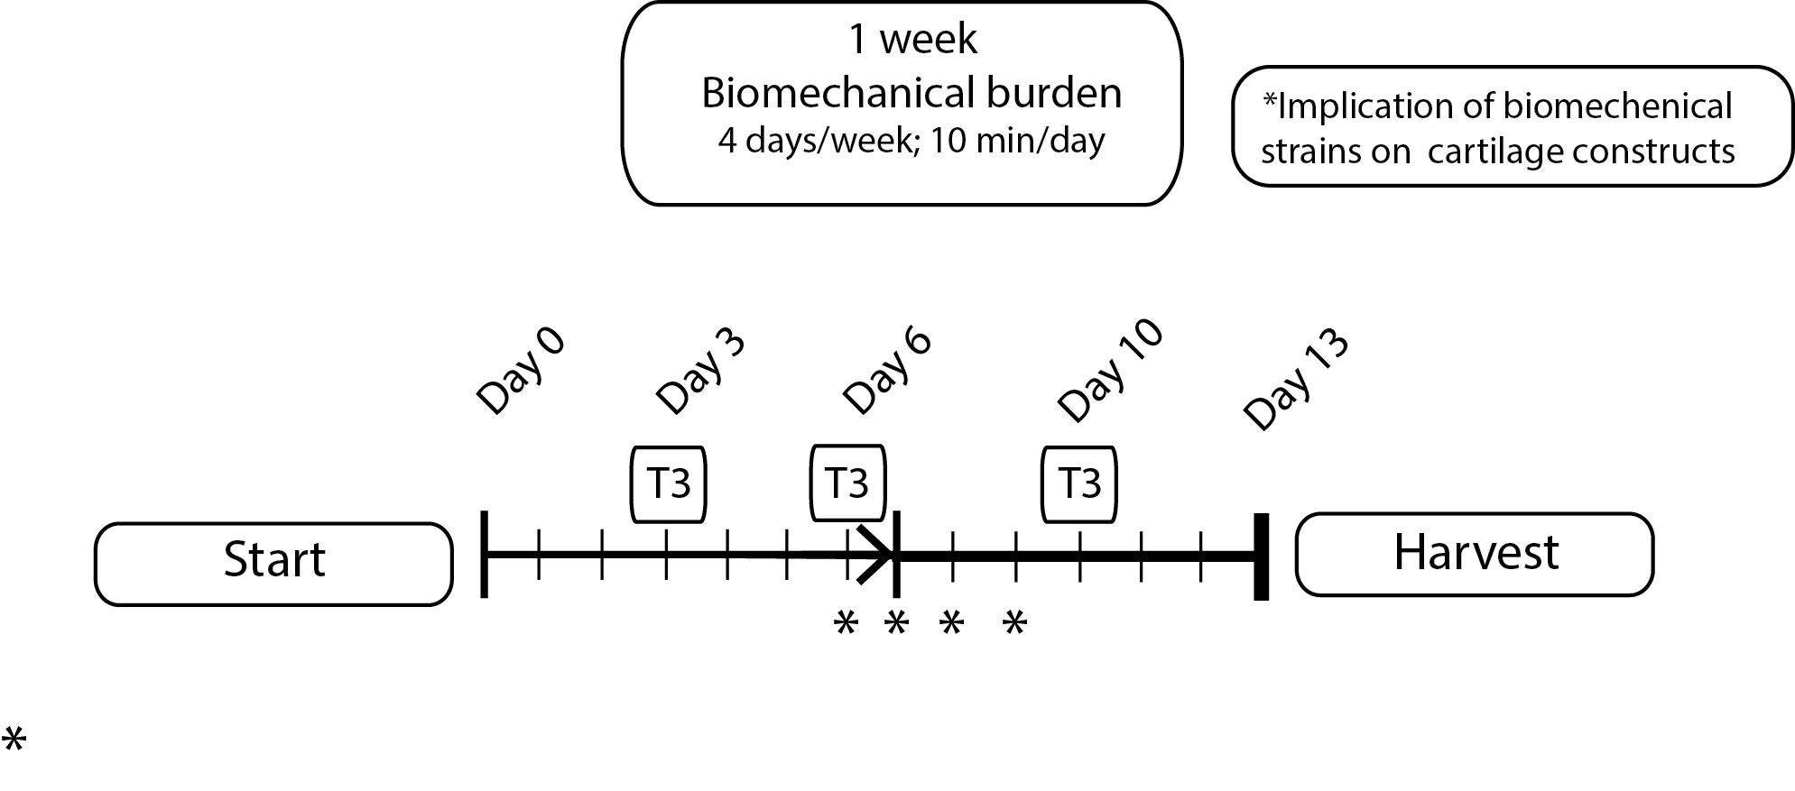
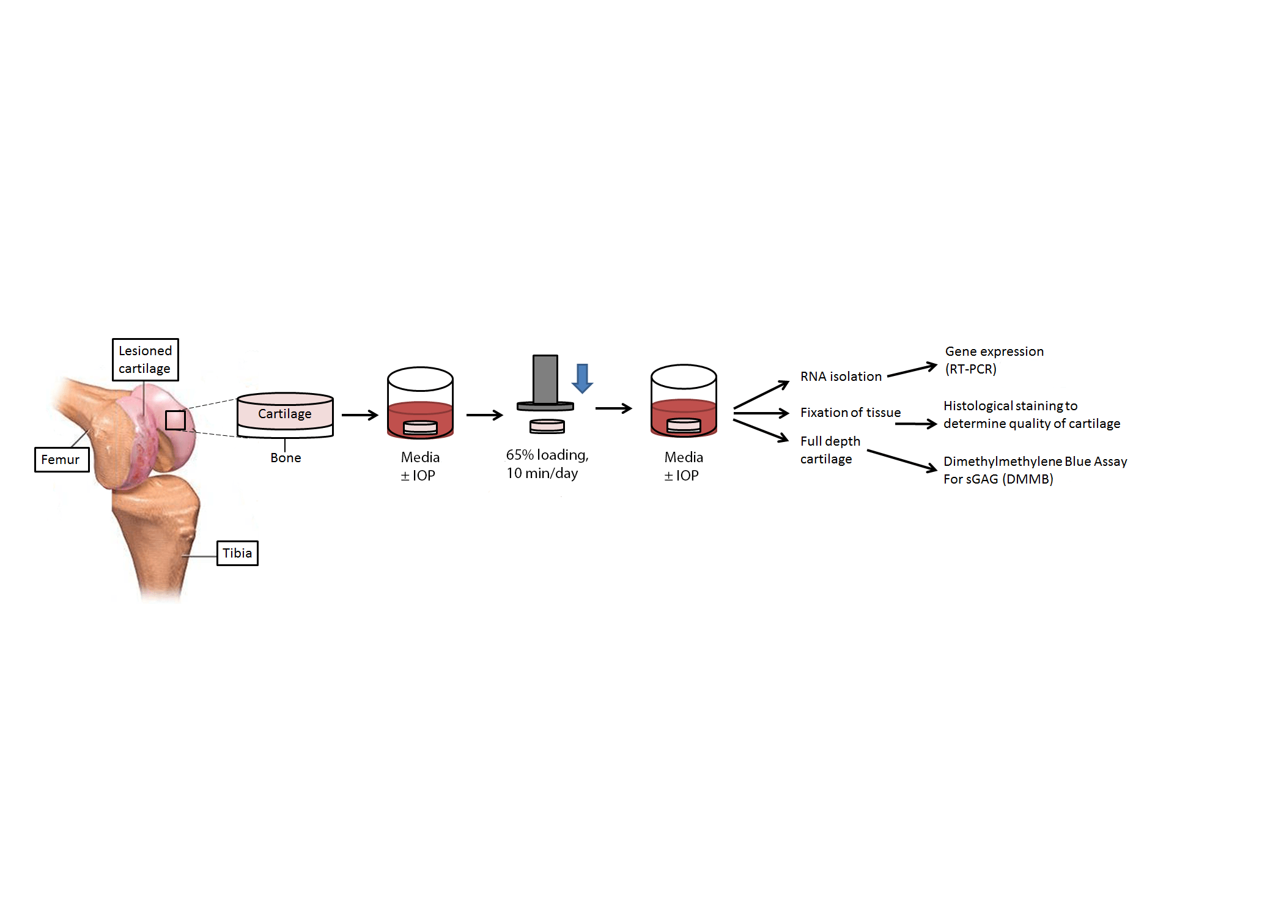
Pharmacological attenuation of thyroid hormone signaling: An evidence based treatment option for Osteoarthritis
The human explant model
Pre-clinical human ex vivo osteochondral explant model
Readout of model:
Gene expression
Sulphated GAG loss
Cartilage structure
Mechanical properties
Start
End
Research Articular osteoArthrits Cartilage: RAAK study (collaboration with Orthopaedics, RGHH Nelissen)

Slide 61
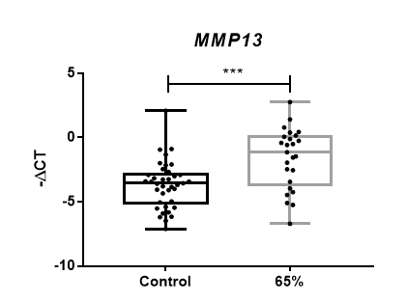




Do high loading strains induce detrimental changes to cartilage?
Model optimization – mechanical loading
Gene expression
Mechanical stress induces detrimental changes to the cartilage:
Increased detrimental gene expression (MMP13)
Reduced matrix producing gene expression (COL2A1)
Increased loss of matrix (sGAG) from cartilage
N=17
Matrix loss
N=17

Slide 62


Pharmacological attenuation of thyroid hormone signaling: An evidence based treatment option for Osteoarthritis
Model optimization – drug delivery
Inhibition of DIO2
Does inhibition of thyroid signaling prevent mechanical induced detrimental changes?
Nanoparticles for delivery of IOP

Slide 63


Can IOP inhibit mechanical induced damage?
Gene expression
Inhibition of thyroid signaling (IOP) alleviated these detrimental changes to the cartilage
N=6
Nanoparticles containing IOP show similar results on gene expression
Matrix loss
N=6

Slide 64


In summary
Risk allele modulates epigenetically regulated transcription of DIO2 in articular cartilage
DIO2 up-regulation affects propensity of chondrocytes to undergo terminal maturation.
Attenuating thyroid signaling may be a key factor in securing joint tissue homeostasis and a likely druggable target

Slide 65



Osteoarthritis research group

